Slide 1
Swiggy Analysis

Slide 2
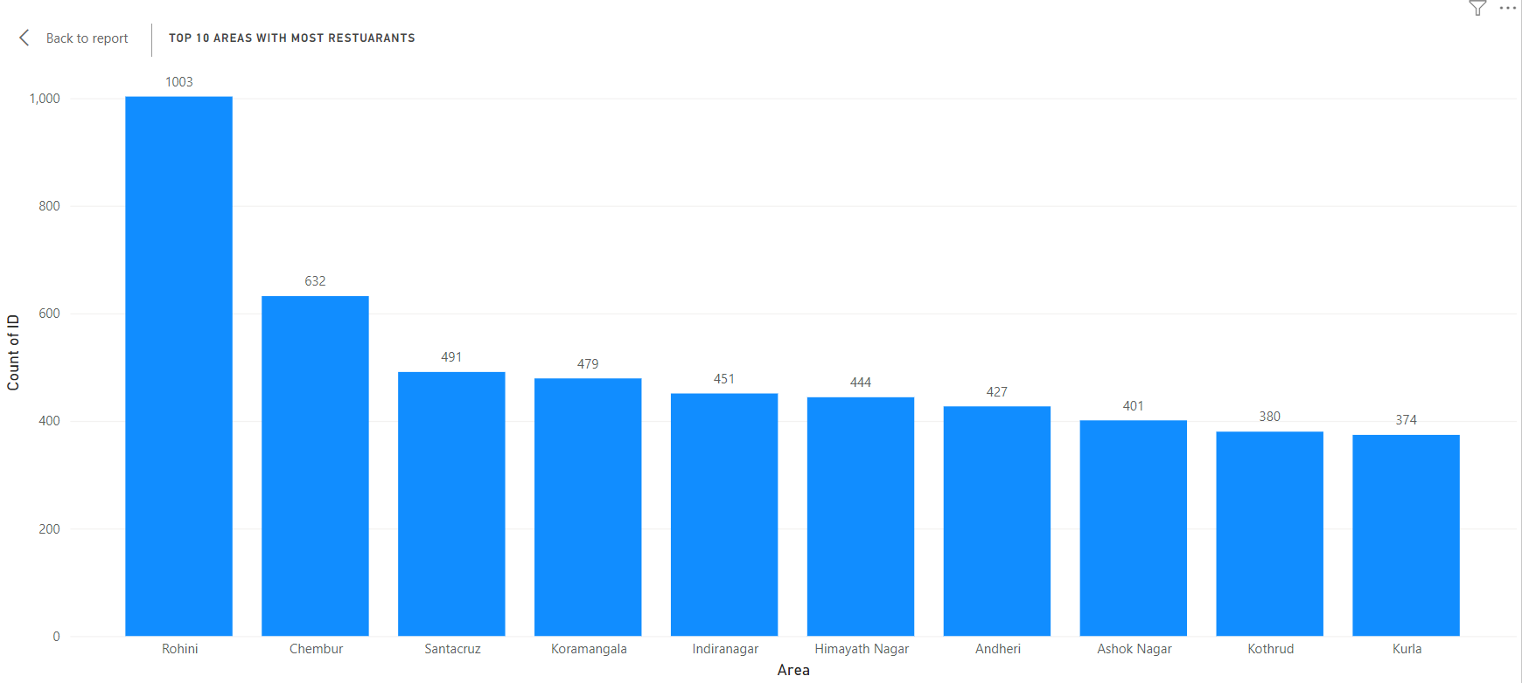
Top 10 Areas with Most Restaurants
Notes:
Rohini is the area with most restuarants

Slide 3
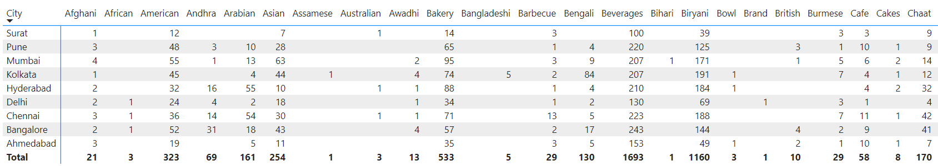
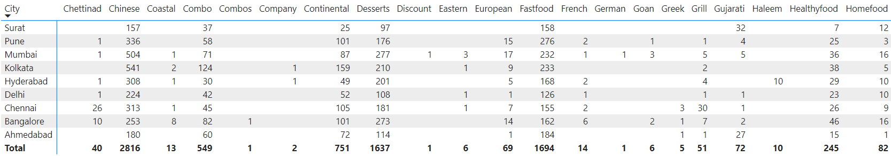
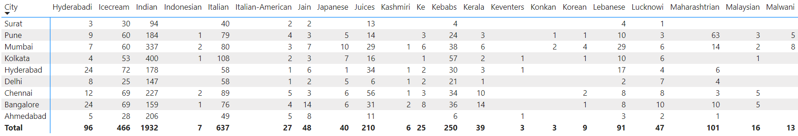
Most Popular Food Types Served by Swiggy Restaurants in Each City

Slide 4
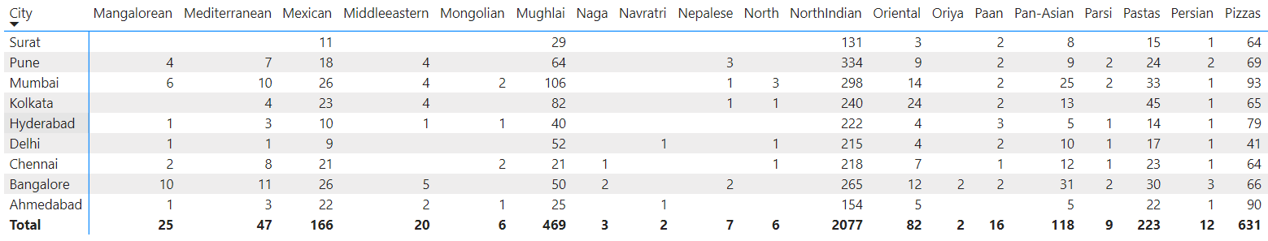
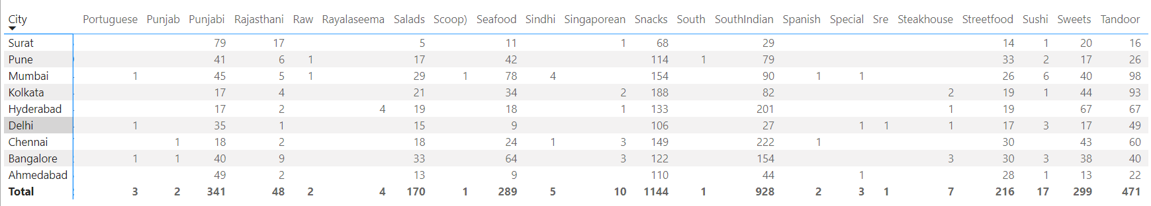
Most Popular Food Types Served by Swiggy Restaurants in Each City (Contd.)

Slide 5
Top Rated Swiggy Restaurants (In Percentage)
3.73
Notes:
3.73% of the restaurants are rated above 4.5

Slide 6
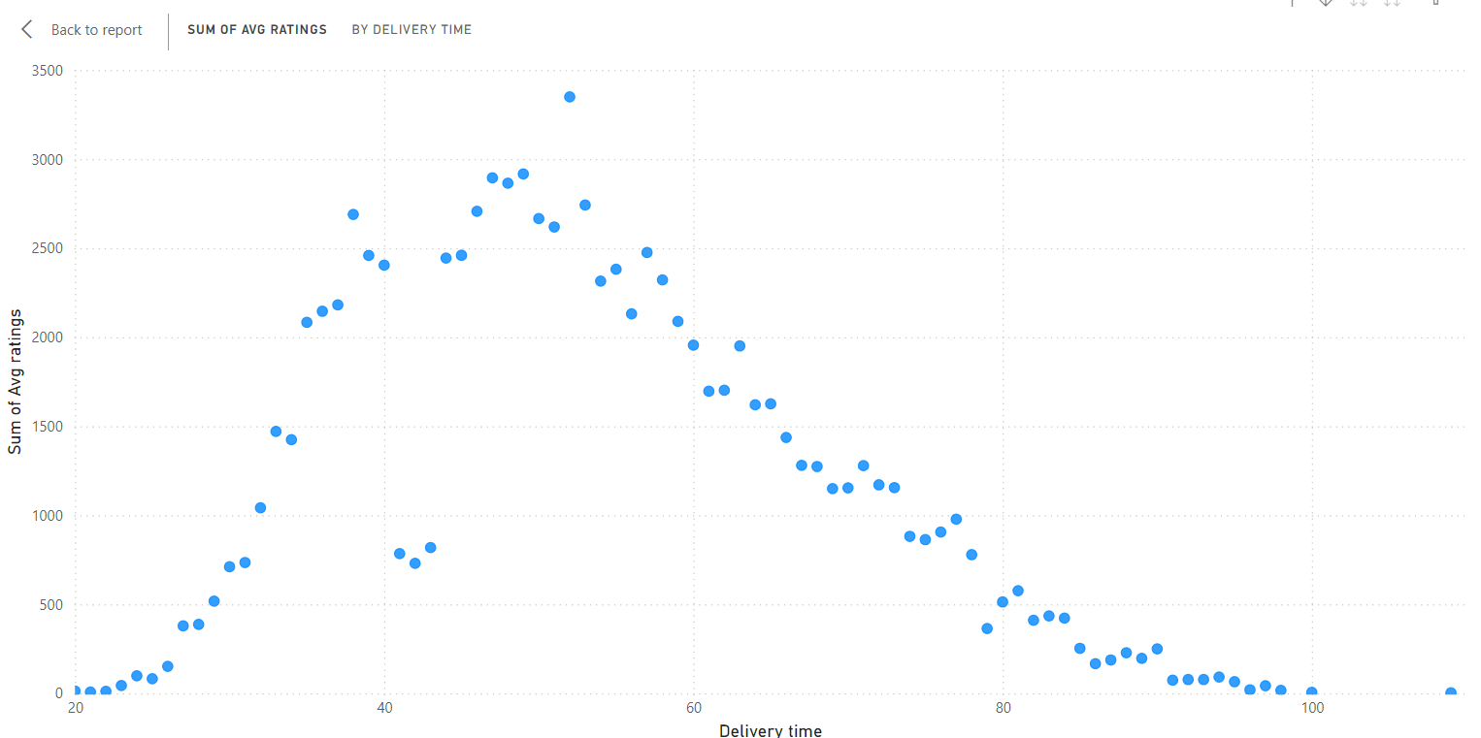

Correlation of Factors Affecting Average Rating
Correlation Coefficient

Slide 7
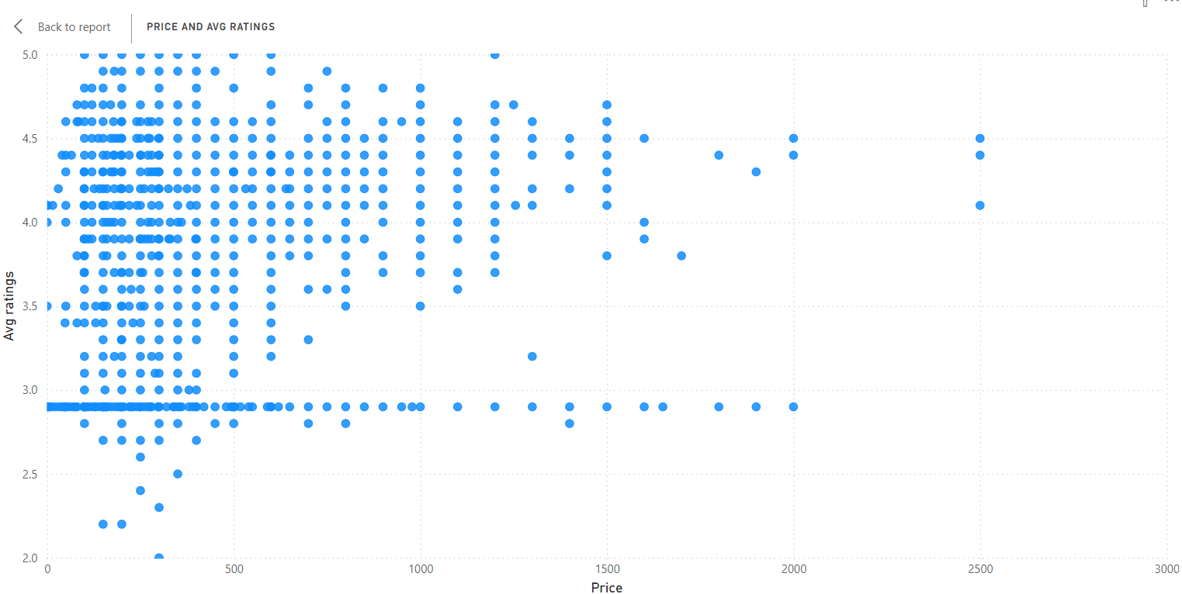
Correlation Between Restaurant Price and Average Rating

Slide 8
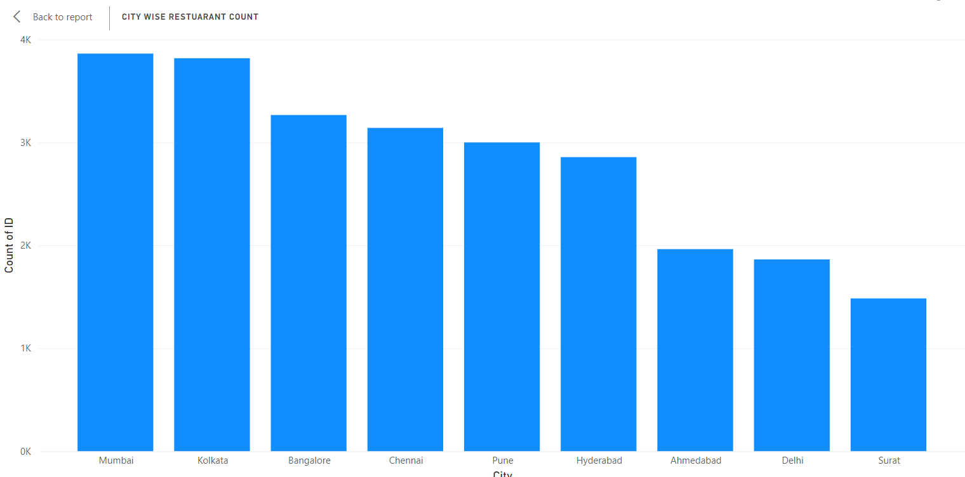
City-wise Restaurant Count

Slide 9
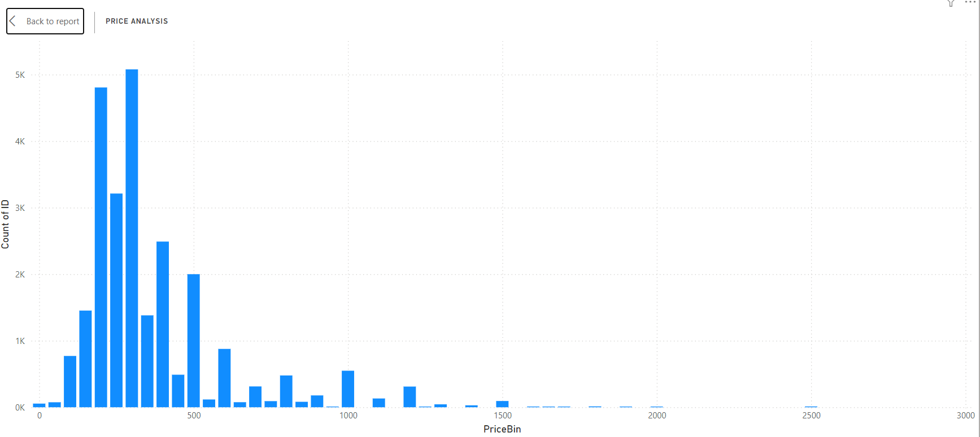
Price Analysis

Slide 10
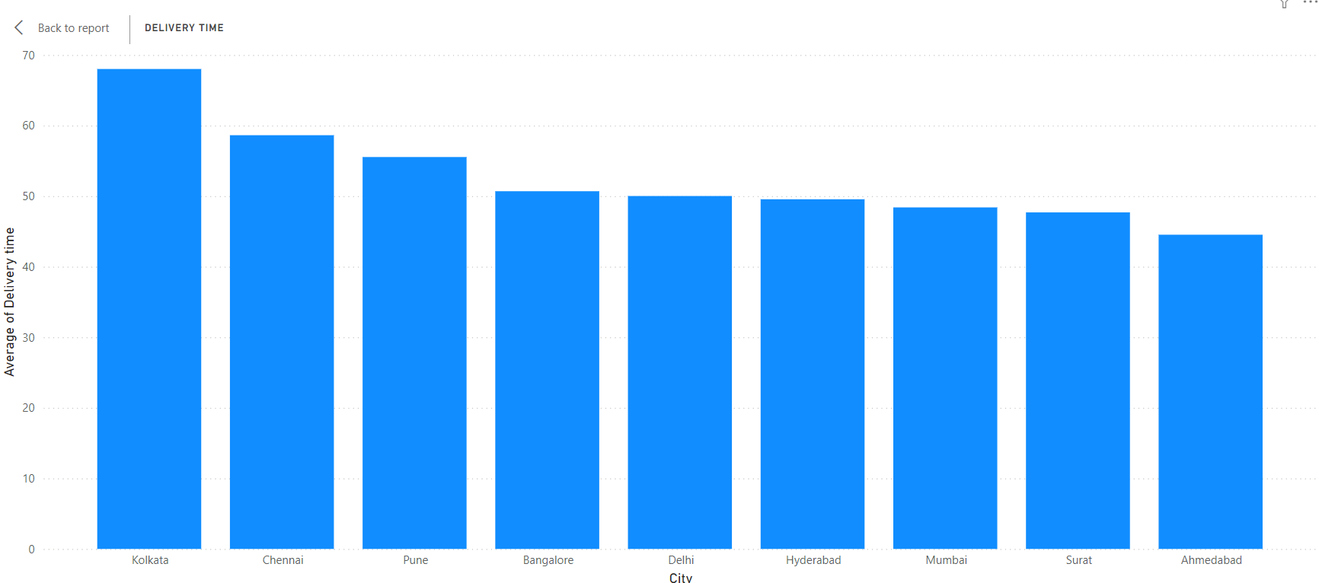
Delivery Time Analysis

Slide 11
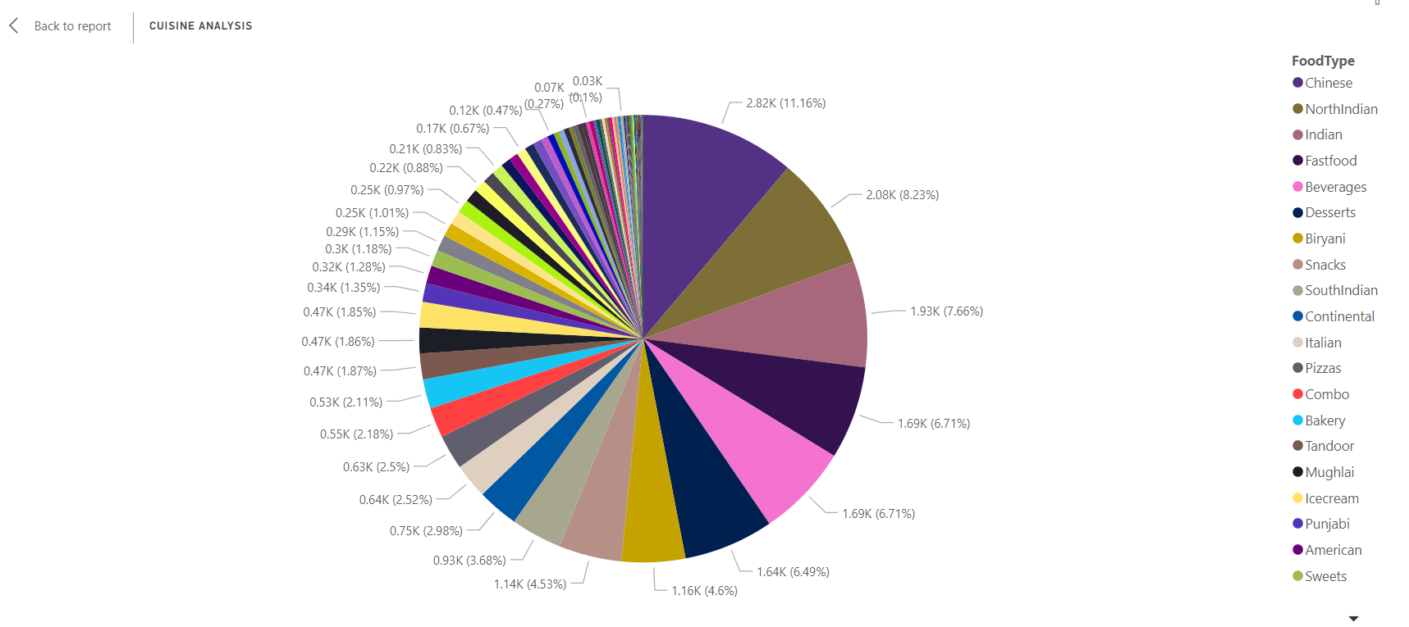
Cuisine Analysis

Slide 12
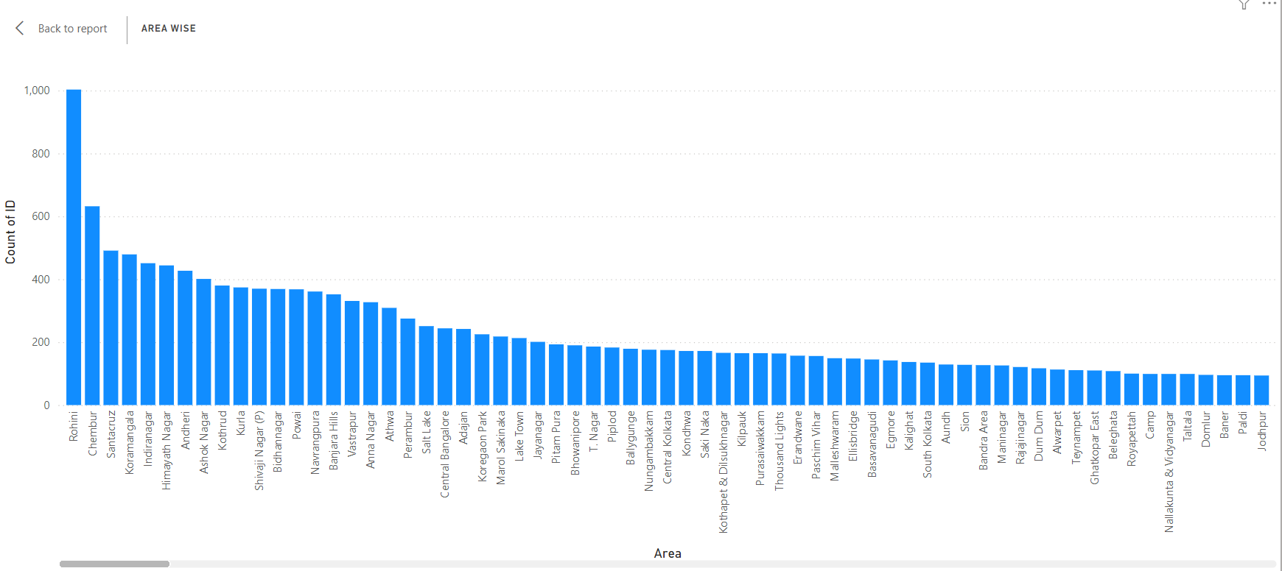
Area-wise Restaurant Analysis

Slide 13
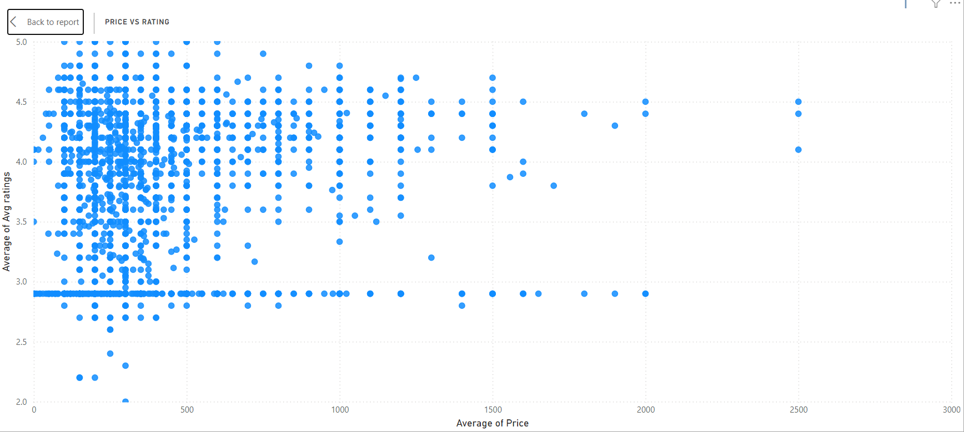
Correlation Analysis

Slide 14
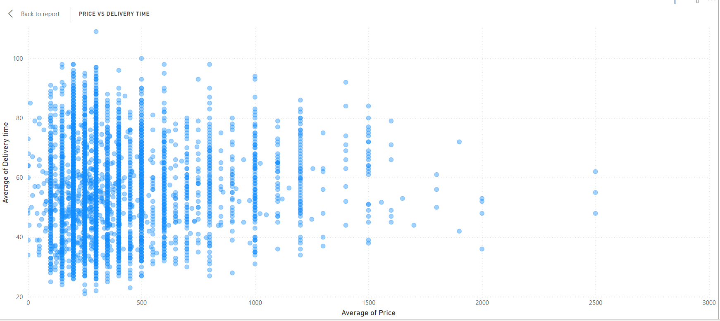
Correlation Analysis

Slide 15
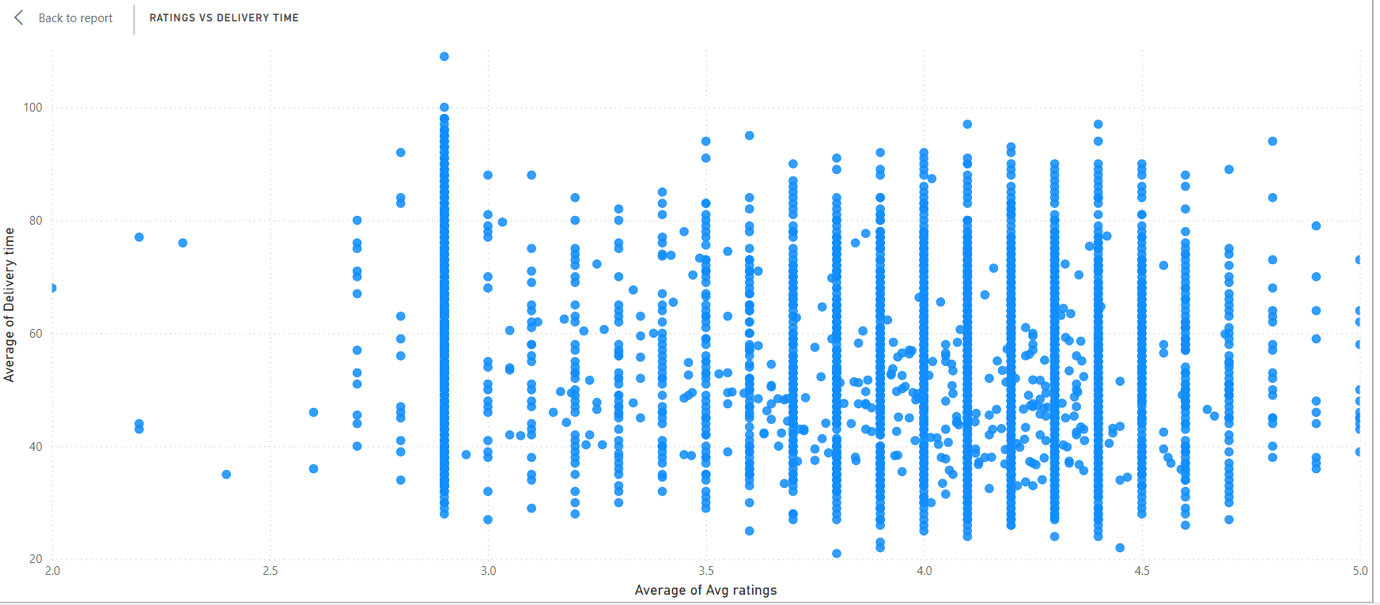
Correlation Analysis

Slide 16
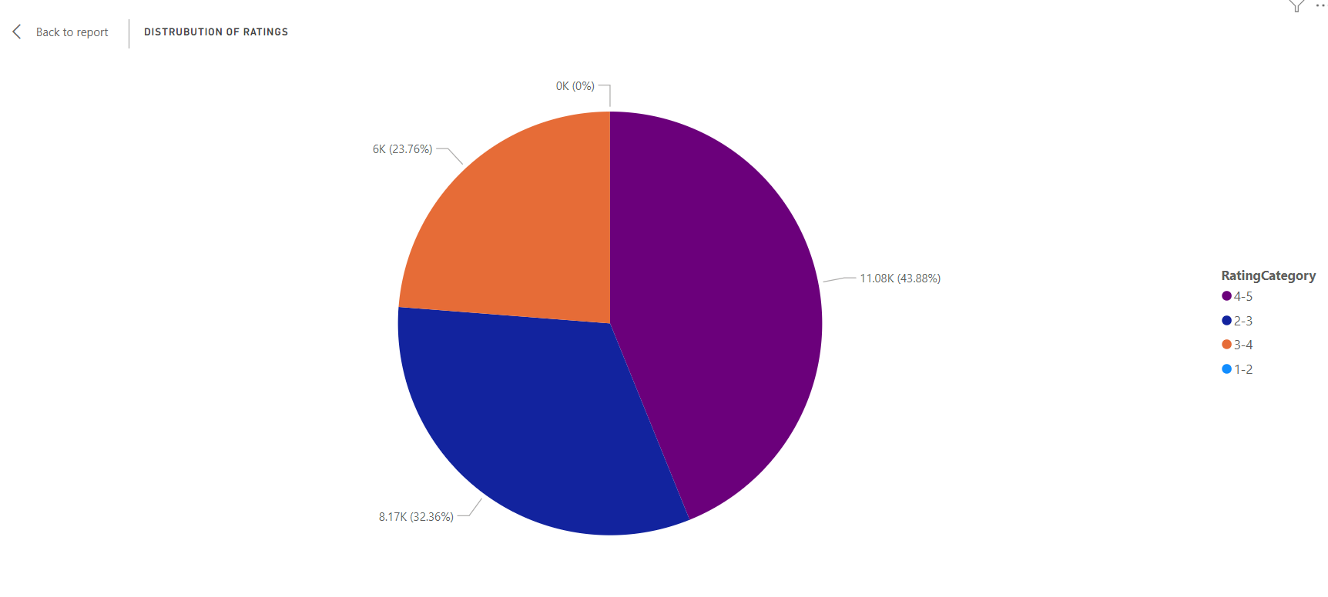
Customer Feedback Analysis

Slide 17
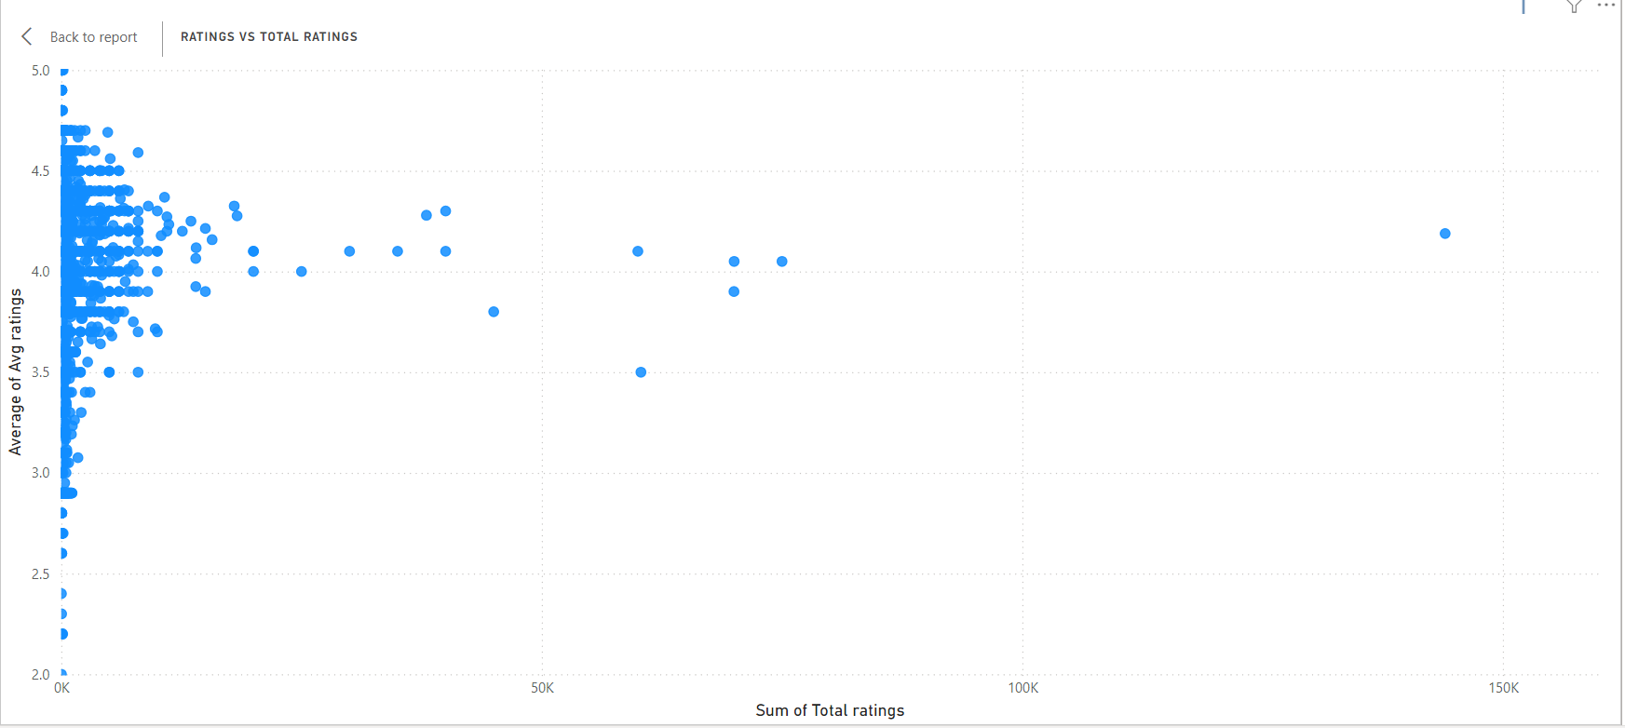
Customer Feedback Analysis

Slide 18
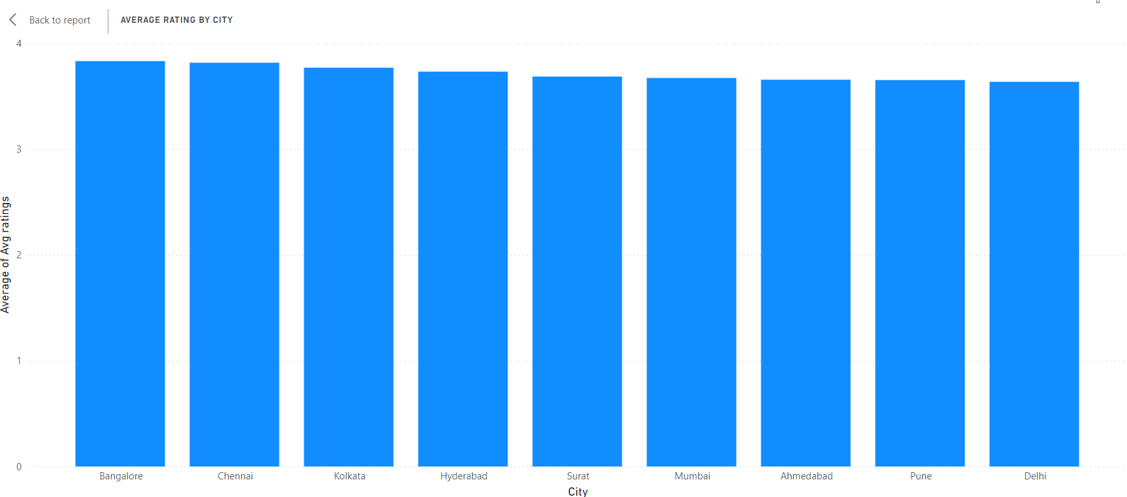
Customer Feedback Analysis

Slide 19
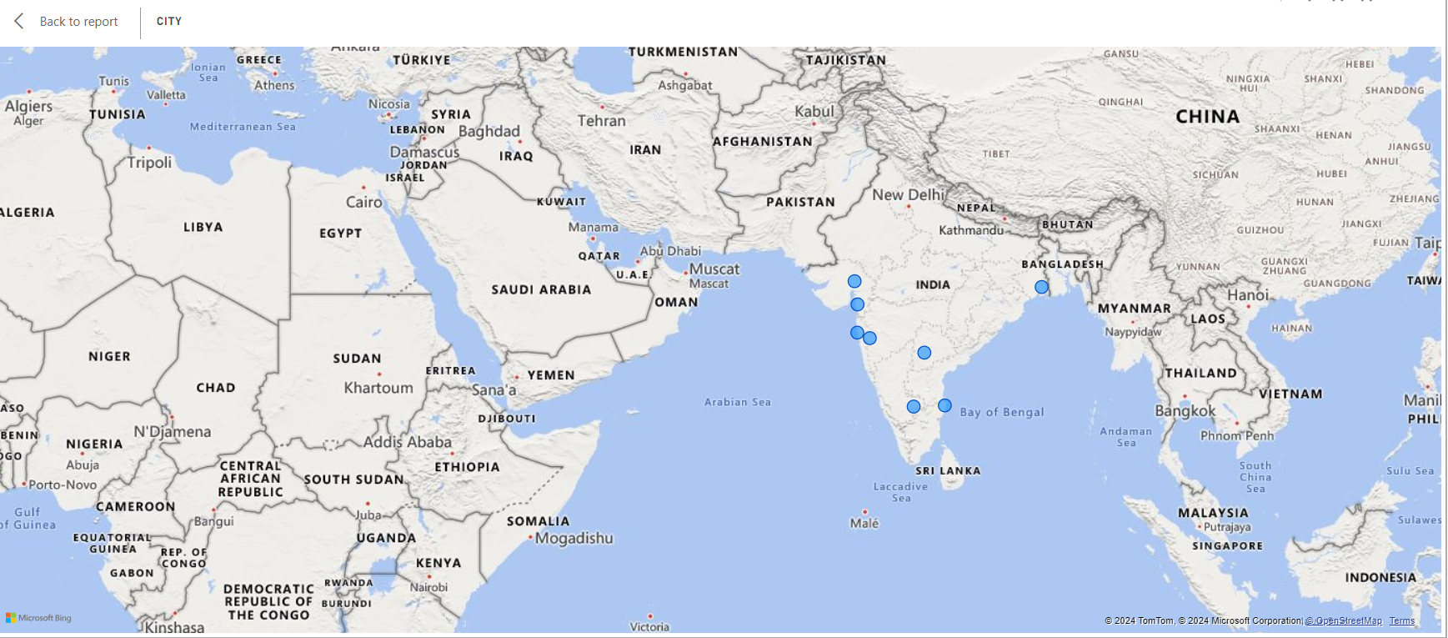
Geographical Mapping

Slide 20
Thank you

